Slide 1



Welltable: Connect with Hotels and Restaurants for Your Next Meeting
Welcome to Welltable, the premier online platform that connects clients looking for meeting space with hotels and restaurants. Our mission is to simplify the process of finding the perfect meeting location, offering a convenient and cost-effective solution for businesses and individuals alike. Welltable provides a seamless experience for both clients and hosts, empowering them to make the most of their time and resources.

Slide 2


About Welltable
Effortless Booking
Flexible Options
Welltable streamlines the meeting booking process. We offer a user-friendly platform where you can easily browse available tables, compare options, and book your meeting space in just a few clicks.
We understand that every meeting is different. Welltable offers various table sizes and configurations to accommodate your needs, whether you're hosting a small team meeting or a larger gathering.
Secure and Reliable
Community Focused
Welltable prioritizes security and reliability. Our platform is designed to protect your information and ensure a smooth and secure booking experience.
Welltable fosters a sense of community by connecting clients and hosts. We encourage interaction and collaboration, creating a network of professionals who share a common goal of successful meetings.

Slide 3

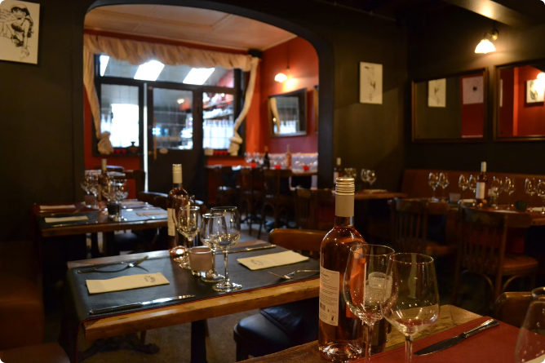
How It Works
1
Search and Discover
Start by searching for available meeting spaces on Welltable. Filter your search by location, date, time, table size, and other preferences to find the perfect option for your needs.
2
Explore Options
Browse through the available tables, view photos, and read descriptions to gain a better understanding of each space. You can also check availability and pricing information directly on the platform.
3
Book Your Table
Once you've found the ideal meeting space, proceed with the booking process. Provide your details, select your preferred time slot, and confirm your booking with a few clicks.
4
Enjoy Your Meeting
On the day of your meeting, head to the chosen location and enjoy a productive and comfortable meeting environment. Welltable ensures a hassle-free experience, allowing you to focus on your meeting objectives.

Slide 4
Browse Available Tables
Location and Date Filters
Table Size and Configuration
Amenities and Features
Welltable allows you to refine your search by entering your desired location and specifying the date and time of your meeting. This helps narrow down your choices and ensures you find a table that fits your schedule.
Filter your search by additional amenities and features, such as Wi-Fi access, audio-visual equipment, or catering options. Welltable provides detailed information about each table, allowing you to make an informed decision.
Select the appropriate table size and configuration based on the number of attendees. Welltable displays various options, from intimate tables for small meetings to larger tables for larger groups.

Slide 5





Book Your Meeting Space
Select Your Table
Confirm Your Details
Make Your Booking
Receive Confirmation
Choose the table that best suits your meeting requirements based on location, size, and amenities.
Review your selected table, meeting time, and contact information to ensure accuracy.
Proceed with your booking by accepting the terms and conditions and making a secure payment through our secure platform.
Upon successful booking, you will receive an instant email confirmation with details of your reservation.

Slide 6

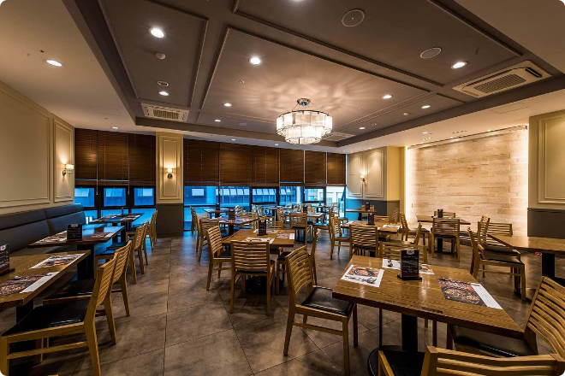
Earn Extra Revenue as a Host
1
Maximize Your Space
2
Attract New Customers
Welltable helps you utilize your available tables efficiently, generating additional revenue by renting them out for meetings during non-peak hours.
By hosting meetings through Welltable, you gain exposure to a wider audience, potentially attracting new customers who may return for dining or other services.
3
Flexible Pricing
4
Easy Management
Welltable offers flexible pricing options for hosts, allowing you to set your rates based on the size and amenities of your tables and the time slot.
Our platform simplifies the management process for hosts. You can easily view upcoming bookings, track revenue, and manage your reservations with just a few clicks.

Slide 7


Flexible Pricing Options
Hourly Rates
Set your hourly rates based on the table size, amenities, and demand.
Package Deals
Offer package deals for longer meetings or multiple bookings, attracting clients with attractive rates.
Discounts and Promotions
Utilize discounts and promotions to attract new clients and boost your revenue during slower periods.

Slide 8



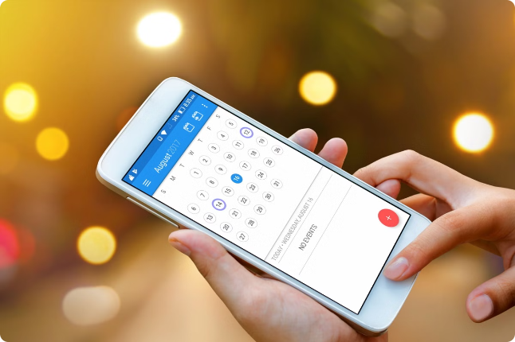


Seamless Booking Process
Calendar Sync
Secure Payment
Integrate your booking calendar with Welltable for seamless scheduling and availability updates.
Process payments securely through Welltable's integrated payment gateway.
Real-Time Notifications
Customer Support
Receive instant notifications about new bookings and updates.
Our dedicated customer support team is available to assist with any queries or issues.

Slide 9
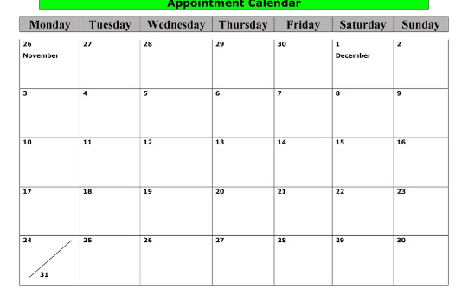
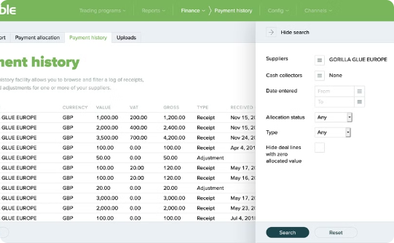
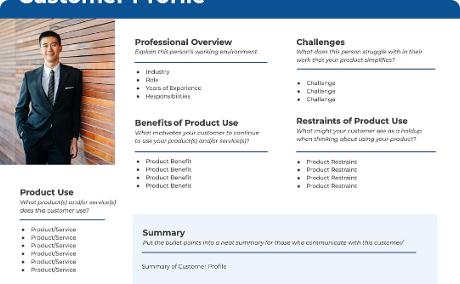
Manage Your Reservations
Calendar View
Payment Tracking
Customer Profiles
View your upcoming bookings and manage your schedule efficiently with our intuitive calendar view.
Track your earnings and payment history for each booking with ease.
Access customer profiles to view booking history and contact information for future reference.

Slide 10

Feedback and Support
We value your feedback and strive to continuously improve our services. If you have any questions, suggestions, or issues, please contact our dedicated customer support team. We are available 24/7 to provide assistance and ensure a positive experience for both clients and hosts.

